Slide 1
Maximizing WTWY Registration Engaging Technology Oriented Academia
Technology
in
Women
Women in Data Analysis
Alison Garrett
17 September 2021

Slide 2
Introduction
This fall WTWY is engaging with the NYC community to introduce their new and inclusive women in technology programs
While WTWY has deployed street teams to the busiest subway stations to introduce WTWY and register interested New Yorkers, bringing in more students and academia foster creative energy
WTWY came to WDA to review the current street team deployment and make recommendations on changes to enhance their outreach to academia

Slide 3
Approach
WDA began by selecting tech-oriented NYC colleges and universities:
Using this list, WDA assessed the 2021 street team deployment to large subway stations and identified additional stations to cover in order to better engage the academic population
Using Fall 2018 (pre-covid data), WDA then assessed the best Stations, Days, and Times to deploy additional WYWT street teams
Brooklyn College (Cuny) | Herbert H Lehman College (Cuny) | Polytechnic University / Metrotech
Columbia University | New School University | Queens College (Cuny)
Cooper Union | New York University | The City College of New York
Fordham University | NYC Technical College (Cuny) | Touro College

Slide 4
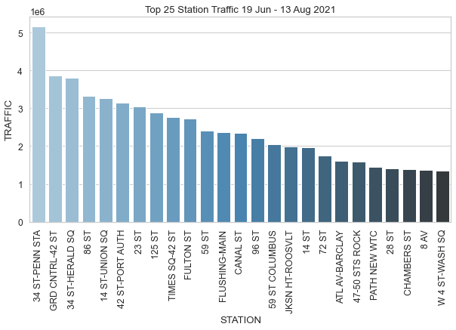


Assessment – Current Deployment
Assessing the current team deployment, there is limited coverage of stations which directly serve technology- oriented colleges and universities
WTWY should consider including these stations in their deployment:
116 ST-COLUMBIA | FLATBUSH AV-B.C
135 ST | JAY ST-METROTEC
6 AV | JAY ST-METROTEC
ASTOR PL | KEW GARDENS
BEDFORD PK BLVD | KINGSBRIDGE RD

Slide 5



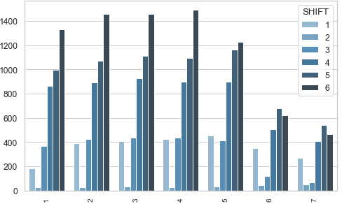
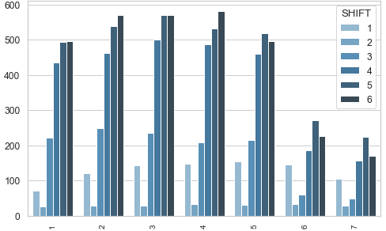
Assessment – Added Street Team Deployment
116 ST – COLUMBIA UNIVERSITY STATION
JAY ST – METROTECH CENTER STATION
Average Daily Station Traffic (Fall 2018)
Mon Tue Wed Thu Fri Sat Sun
Mon Tue Wed Thu Fri Sat Sun
Peak street team deployment times are Tue, Wed, Thu, 1600 - 2400

Slide 6
Recommendations
Through Fall 2021, until the WTWY achieves registration and gala commitment targets for academia,
Deploy a street team twice a week on Tuesday and Wednesday between 4pm and midnight to register a Columbia University population
Deploy a street team once a week on Thursday between 4pm and midnight to register a Polytechnic Institute and City Tech population
Should this registration be insufficient to meet objectives, consider placing street teams at subway stations near additional colleges and universities; WDA has completed the assessment of these locations and can recommend prime day / time schedules by location
135 ST: The City College of New York | FLATBUSH AV-B.C: Brooklyn College (Cuny)
6 AV : New School University / The New School | JAMAICA 179 ST: St. John's University / Queens Campus
ASTOR PL: Cooper Union | KEW GARDENS: Queens College (Cuny)
BEDFORD PK BLVD: Herbert H Lehman College (Cuny) | KINGSBRIDGE RD: Fordham University

